Slide 1

DAR ES SALAAM INSTITUTE OF TECHNOLOGY
TITLE: DESIGN AND IMPLEMENTATION OF INTELLIGENT AND EFFICIENT TOMATO SORTING MACHINE WITH PRECISION AT ULANGA FOOD PANTRY
TYPE: PROBLEM SOLVING
NAME: MORICE KURUSANGA
REG. NUMBER: 2103303219562
CLASS: BENG21-EE

Slide 2
PROBLEM STATEMENT:
The manual sorting of tomatoes in agricultural is a labor-intensive, time-consuming and error prone process.This often leads to inefficient, reduce productivity and increased operational costs. Also human error in sorting can affect the overall quality of the end product, impacting customer satisfaction and market value.
To address these challenges, there is a need of an intelligent, automated sorting machine that can efficiently sort tomatoes based on ripeness and its quality. This system will improve sorting speed and reduce labor dependency.

Slide 3
OBJECTIVES
Main Objective
To design and implement of an intelligent and efficient tomato sorting machine with precision at Ulanga food pantry.
Specific objectives
To design an intelligent tomato sorting machine based on machine learning.
To simulate the assemble circuit.
To build and test the prototype.

Slide 4
SIGNIFICANCE OF THE PROJECT
The proposed system will reduce cost and labor dependency
The proposed system will enhance time management
The proposed system will ensure consistent quality of sorted tomatoes
The proposed system will promote technological advancement in agriculture specifically tomato farming
The proposed system will enable long and efficient preservation of tomatoes

Slide 5
METHODOLOGY
Literature review.
Data collection.
Data analysis.
Design of the proposed system.
Simulation of the proposed system.
Circuit simulation.
Prototype building.
Prototype testing.

Slide 6
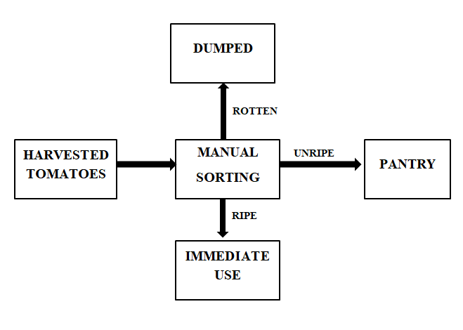
BLOCK DIAGRAM OF EXISTING SYSTEM

Slide 7
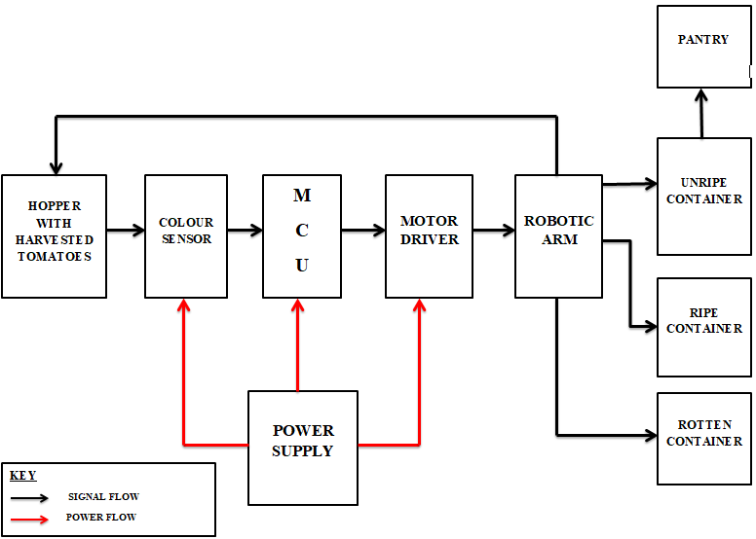
PROPOSED SYSTEM BLOCK DIAGRAM

Slide 8
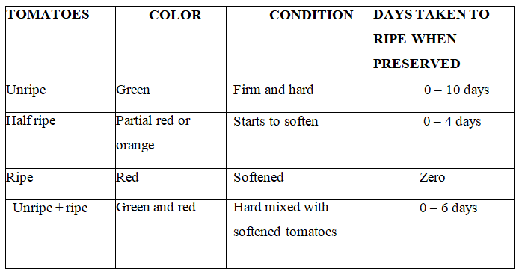
DATA COLLECTION.
PRIMARY DATA

Slide 9
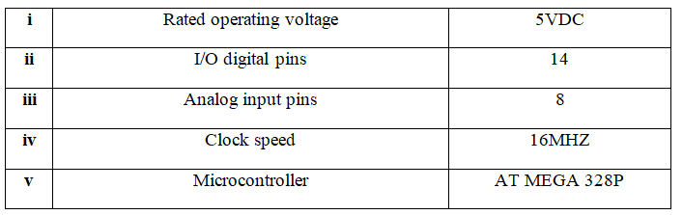
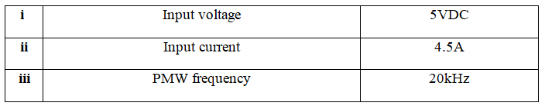
SECONDARY DATA
Microcontroller specifications.
Motor driver

Slide 10
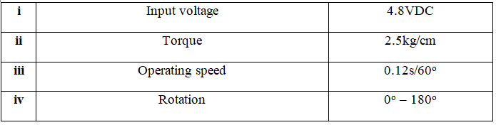

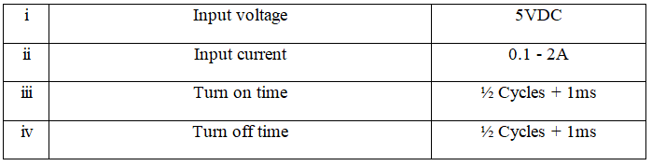
Servo motor
Relay

Slide 11
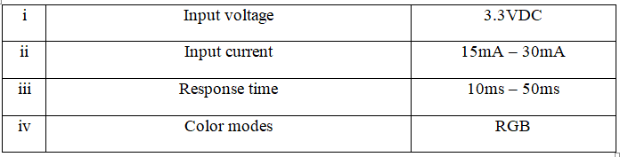
Color sensor

